Slide 1
PhotonHub Demo Centre
Course 01
Optical Fibre Sensing Applications
Course Provider
Brussels Photonics,
Vrije Universiteit Brussel,
Belgium
European Photonics Innovation Academy

Slide 2
Course Overview
Optical fibre sensors (OFS) are part of the field of optical metrology, which is the science and technology of performing measurements with light. An optical fibre sensor encodes a measurand of interest (the perturbation that you want to measure) in one (or more) properties of an optical signal that is guided through an optical fibre.
This one-day hands-on training course provides industry, especially those addressing a sensorization need, with a detailed overview of important point and distributed OFS sensing techniques and how they are applied in engineering environments.
The course will focus on three hands-on sessions; 1) Fabrication and Characterization of fibre Bragg gratings (FBGs); 2) Measurement campaign with FBGs and optical frequency domain reflectometry (OFDR); 3) Processing of raw data into engineering values & Interpretation; Course attendees will learn how OFS are fabricated, installed and interrogated and what measurements they deliver.
European Photonics Innovation Academy

Slide 3
Target Audience
It is desirable but not essential that course attendees have a basic understanding of photonics. The course is ideally suited to those planning to implement optical fibre sensors.
Expected Outcomes
Understanding of operation principles of optical fibre sensors
See the fabrication process to produce fibre Bragg gratings (hands-on activity)
Perform measurements on an asset instrumented with optical fibre sensors (hands-on activity)
Understand, process and interpret the raw sensor data (hands-on activity)
European Photonics Innovation Academy

Slide 4
Course Schedule
Time | Demo Activity
09:00 – 10:30 | VUB B-PHOT Orientation, Course Introduction & Tutorial
11:00 – 12:30 | Demo 1: Fabrication and Connectorisation of a FBG-based sensor chain (hands-on)
13:30 – 15:00 | Demo 2: Measurement campaign with FBGs and OFDR (hands-on)
15:30 – 17:00 | Demo 3: Processing of raw data into engineering values & Interpretation (hands-on)
17:00 – 17:30 | Follow-Up Questions & Close
European Photonics Innovation Academy

Slide 5
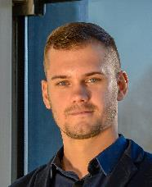
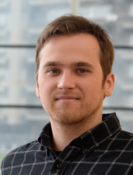
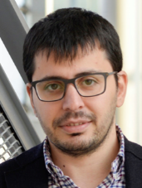
Course Trainers
Course Director: Prof. Hugo Thienpont
Demo 1: Dr. Sidney Goossens, Prof. Tigran Baghdasaryan
Demo 2: Dr. Sidney Goossens, Dr. Sergei Mikhailov
Data processing: Dr. Sidney Goossens, Dr. Sergei Mikhailov
European Photonics Innovation Academy

Slide 6
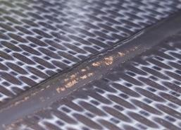
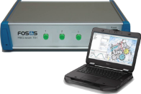
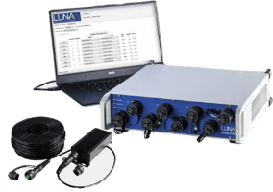
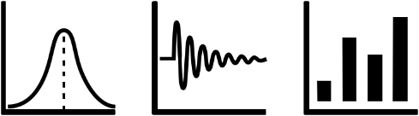
Course hands-on sessions
Fabrication and connectorization of fibre Bragg grating sensor chains
Measurement campaign with FBGs and OFDR
Processing of raw data into engineering values & Interpretation
European Photonics Innovation Academy

Slide 7
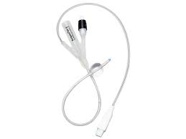
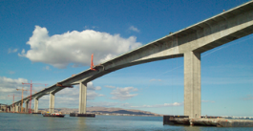
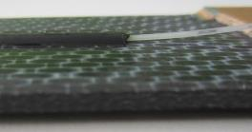
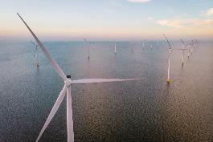
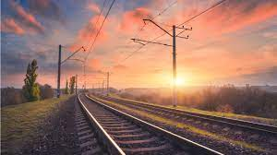
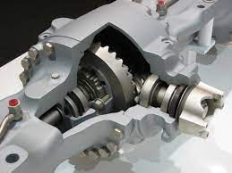

Industrial application sectors of FOS
Smart catheters
Bridges
Composite materials
Wind turbines
Railways
Smart mechatronics
Smart energy grids
European Photonics Innovation Academy

Slide 8
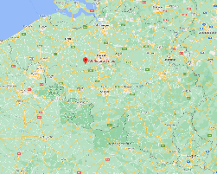
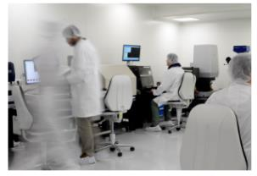

Course Location, Schedule & Cost
VUB Photonics Campus
Gooik, Belgium
Course Schedule (13 November, 28 November)
Number of people (Groups of 3/6 people per course)
Further Information
https://www.b-phot.org/contact
European Photonics Innovation Academy

Slide 9
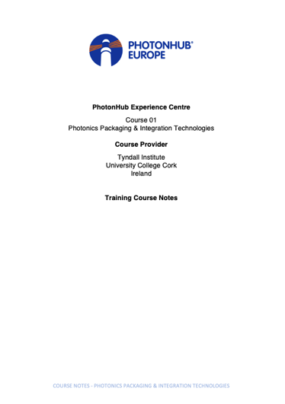
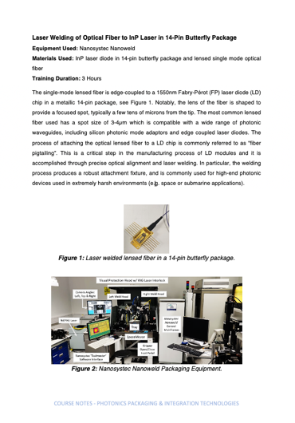
Course Material (technical hand-outs)
PhotonHub Demo Centre
Course 01
Optical Fibre Sensing Applications
Course provider
Brussels Photonics,
Vrije Universiteit Brussel,
Belgium
Training Course notes
European Photonics Innovation Academy

Slide 10
Keywords
Optical measurement, Sensor, Optical Fibre, Manufacturing, Pilot Line, Equipment, Automation, Optical fibre sensing, strain and temperature sensing, structural health monitoring, Fibre Bragg grating, Distributed sensing, Data interpretation and reporting
Relevant Technology & Application Domain
Technology: Glass and Polymer Specialty Fibres and Fibre Devices
Application: Relevant to all application domains
European Photonics Innovation Academy

