Slide 1

PhotonHub Demo Centre
Course 02
Laser-based Additive Micro-Manufacturing for industrial applications
Course Provider
Non-Linear Lithography Group (NLL),
Institute of Electronic Structure and Laser,
Foundation for Research and Technology- Hellas
Greece
European Photonics Innovation Academy

Slide 2
Course Overview
Additive Manufacturing (AM), has been established as the manufacturing technology of choice in a variety of industries, from aerospace, to automotive, medical devices, and photonics.
Multiphoton Lithography (MPL) is a laser-based AM technique which enables the “direct writing” of computer-designed structures with submicron resolution. Based on the phenomenon of multiphoton absorption, MPL is the only technique that can provide freeform 3D nanoprinting.
The course will focus on three technology demonstrators:
a) Micro-optics
b) Architected Mechanical Structures
c) Biomedical Microdevices.
The design, and fabrication of microstructures will be covered through tutorials and hands-on experience training. Extra weight will be placed on choosing the right photopolymer for each application
European Photonics Innovation Academy

Slide 3
Target Audience
It is desirable but not essential that course attendees have a basic understanding of additive manufacturing using MPL. The course is ideally suited to those seeking to adopt new AM technologies in order to advance manufacturing facilities in terms of productivity and efficiency.
Expected Outcomes
Understanding of key features of of additive micromanufacturing
Participate in the fabrication of high-resolution 3D components using tailor-made materials
Observe and evaluate working micro-components, such as axicons on fibers(hands-on activity)
Communicate and seek solutions for specific concerns related to additive micro-manufacturing
European Photonics Innovation Academy

Slide 4
Course Schedule
Time | Demo Activity
09:00 – 10:30 | FORTH Orientation, Course Introduction & Tutorial
11:00 – 12:30 | Demo 1: Micro-optical element fabrication and characterization (hands-on)
13:30 – 15:00 | Demo 2:Modelling and fabrication of structures with negative Poisson’s ratio (auxetics) (hands-on)
15:00 – 16:30 | Demo 3: 3D scaffold fabrication, for cell growth (hands-on)
16:30 – 17:30 | Follow-Up Questions & Close
European Photonics Innovation Academy

Slide 5
Course Trainers
Course Manager
Maria Farsari
Demo 1
Vasileia Melissinaki
Demo 2
Elmina Kabouraki
Demo 3
George Flamourakis
The AM setup ar FORTH/IESL
European Photonics Innovation Academy

Slide 6
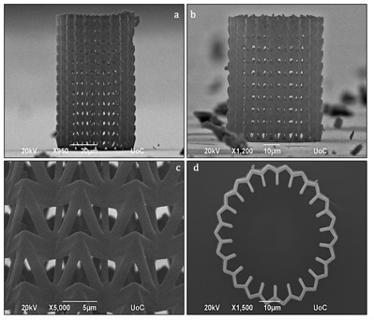
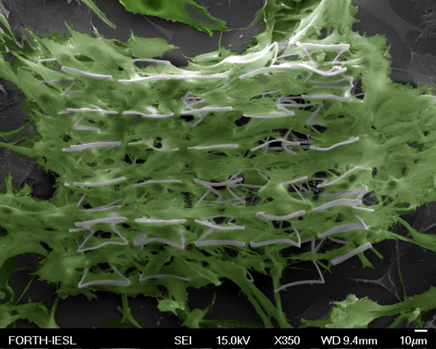
Course Demonstrators
Demo 1: Axicon
on optical fiber
Demo 3: Cells growing on an auxetic scaffold
Demo 2: Auxetic Stent
Demo 1: Lens
European Photonics Innovation Academy

Slide 7
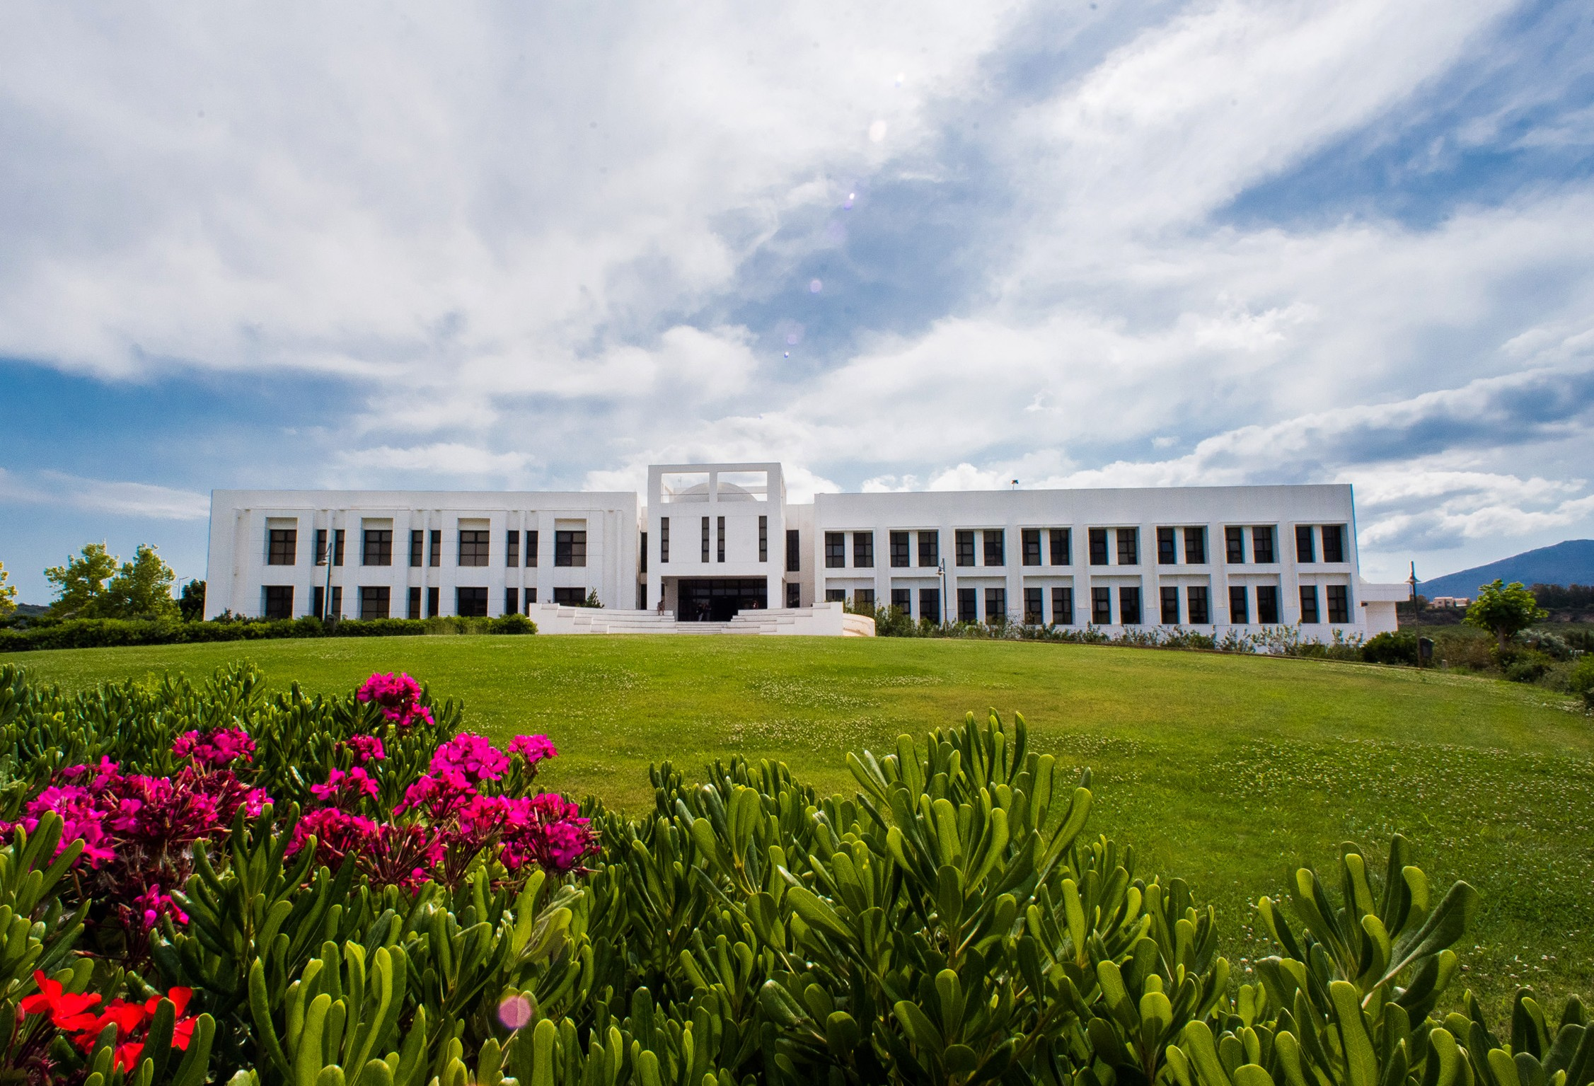
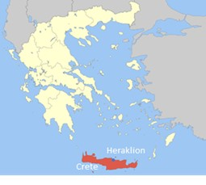
Course Location, Schedule & Cost
Foundation for Research and Technology- Hellas (FORTH)
Crete, Greece
Course Schedule (September, June – exact dates to be confirmed)
Number of people (Groups of 3/6/9 people per course)
Course Cost (300 Euros per person, includes catering and project consumables)
Further Information
mfarsari@iesl.forth.gr
https://www.iesl.forth.gr/en/research/NLL_Group
www.photonhub.eu/euphotonicsacademy
European Photonics Innovation Academy

Slide 8
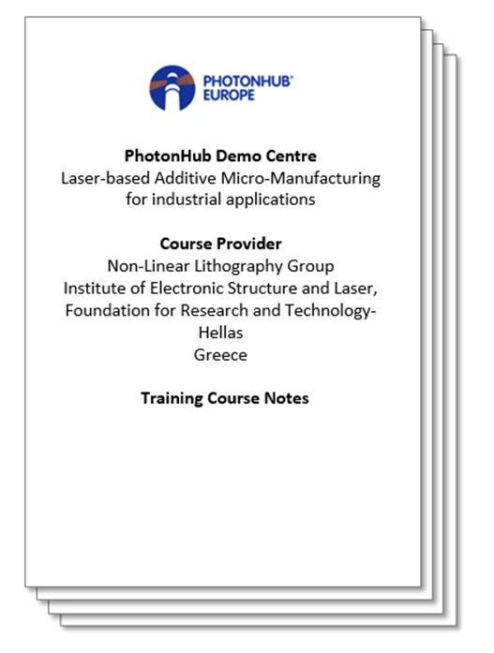
Course Material (technical hand-outs)
& USB with electronic files/media/practices
European Photonics Innovation Academy

Slide 9
Keywords
Additive Manufacturing, Multiphoton Lithography, 3D nanoprinting, Micro-optical elements, Laser, Photonics, Equipment, Automation, Manufacturing
Relevant Technology & Application Domain
Technology: Laser-Based Equipment and Manufacturing, Photonics Assembly
Application: Relevant to several application domains
European Photonics Innovation Academy

