Slide 1
PhotonHub Demo Centre
Course:
Operating and digitalization of laser manufacturing cells
Course Provider
CARTIF,
Spain
European Photonics Innovation Academy

Slide 2
Course Overview
Laser has become one of the most important tools in manufacturing. Its flexibility and operation possibilities ranging from cutting and welding to surface treatment make it one of the key tools to optimize manufacturing processes.
This one-day hands-on training course provides a first contact on how to operate with a laser manufacturing cell, giving an overview of the main elements in a cell (laser sources, laser paths, laser heads, coolers and exhaust systems, CNC/robot systems, assistant gases,…), dealing with safety issues and exploring the possibilities of digitalization (Industry 4.0). It’s an introductory course especially suitable to those who are new or have a little experience with laser manufacturing equipment.
European Photonics Innovation Academy

Slide 3
Target Audience
The course is indicated to machine shops and SMEs interested in adopting / acquiring laser technologies for manufacturing in their facilities. It is desirable but not essential for those attending the course to have a technical profile.
Expected Outcomes
Understanding of the fundamentals of laser cutting and welding.
Understanding the basic elements of a manufacturing laser cell.
Knowledge of the basic operations to perform a cutting job in a laser cell.
Knowledge of devices for the digitization of a laser cell (Industry 4.0)
European Photonics Innovation Academy

Slide 4
Course Schedule
Time | Demo Activity
09:00 – 09:15 | Welcome and course introduction
09:15 – 10:00 | Laser fundamentals and safety issues.
10:00 – 11:00 | Basic laser cell elements (hands-on)
11:30 – 14:15 | Laser cell operation: Creation and execution of a part cutting/marking program (hands-on)
15:15 – 16:15 | Digitalization: Laser cell working parameters monitoring/sensors. (hands-on)
16:15 – 17:15 | Digitalization: Sharing (Opc UA, IoT gateways) and analyzing laser cell data (hands-on)
17:15 – 17:30 | Follow-Up Questions & Close
European Photonics Innovation Academy

Slide 5
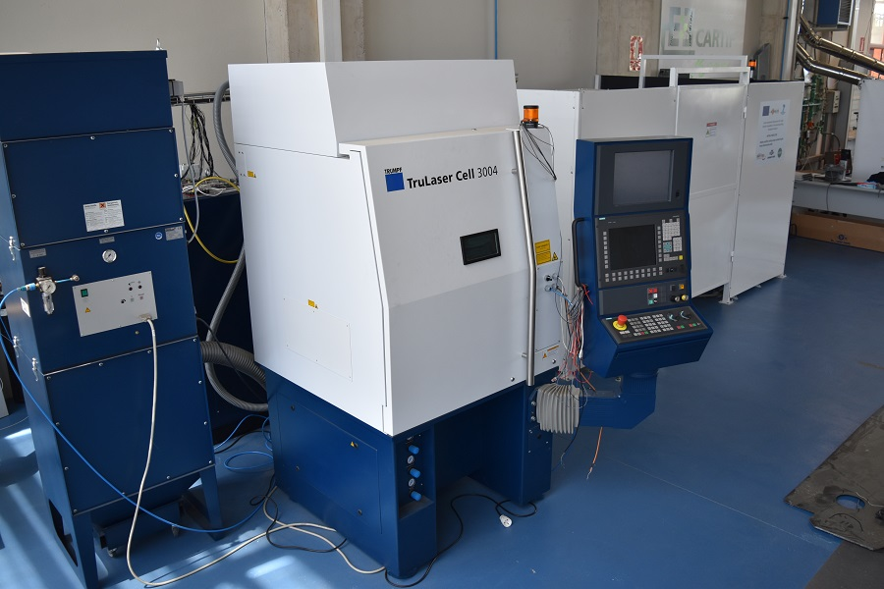
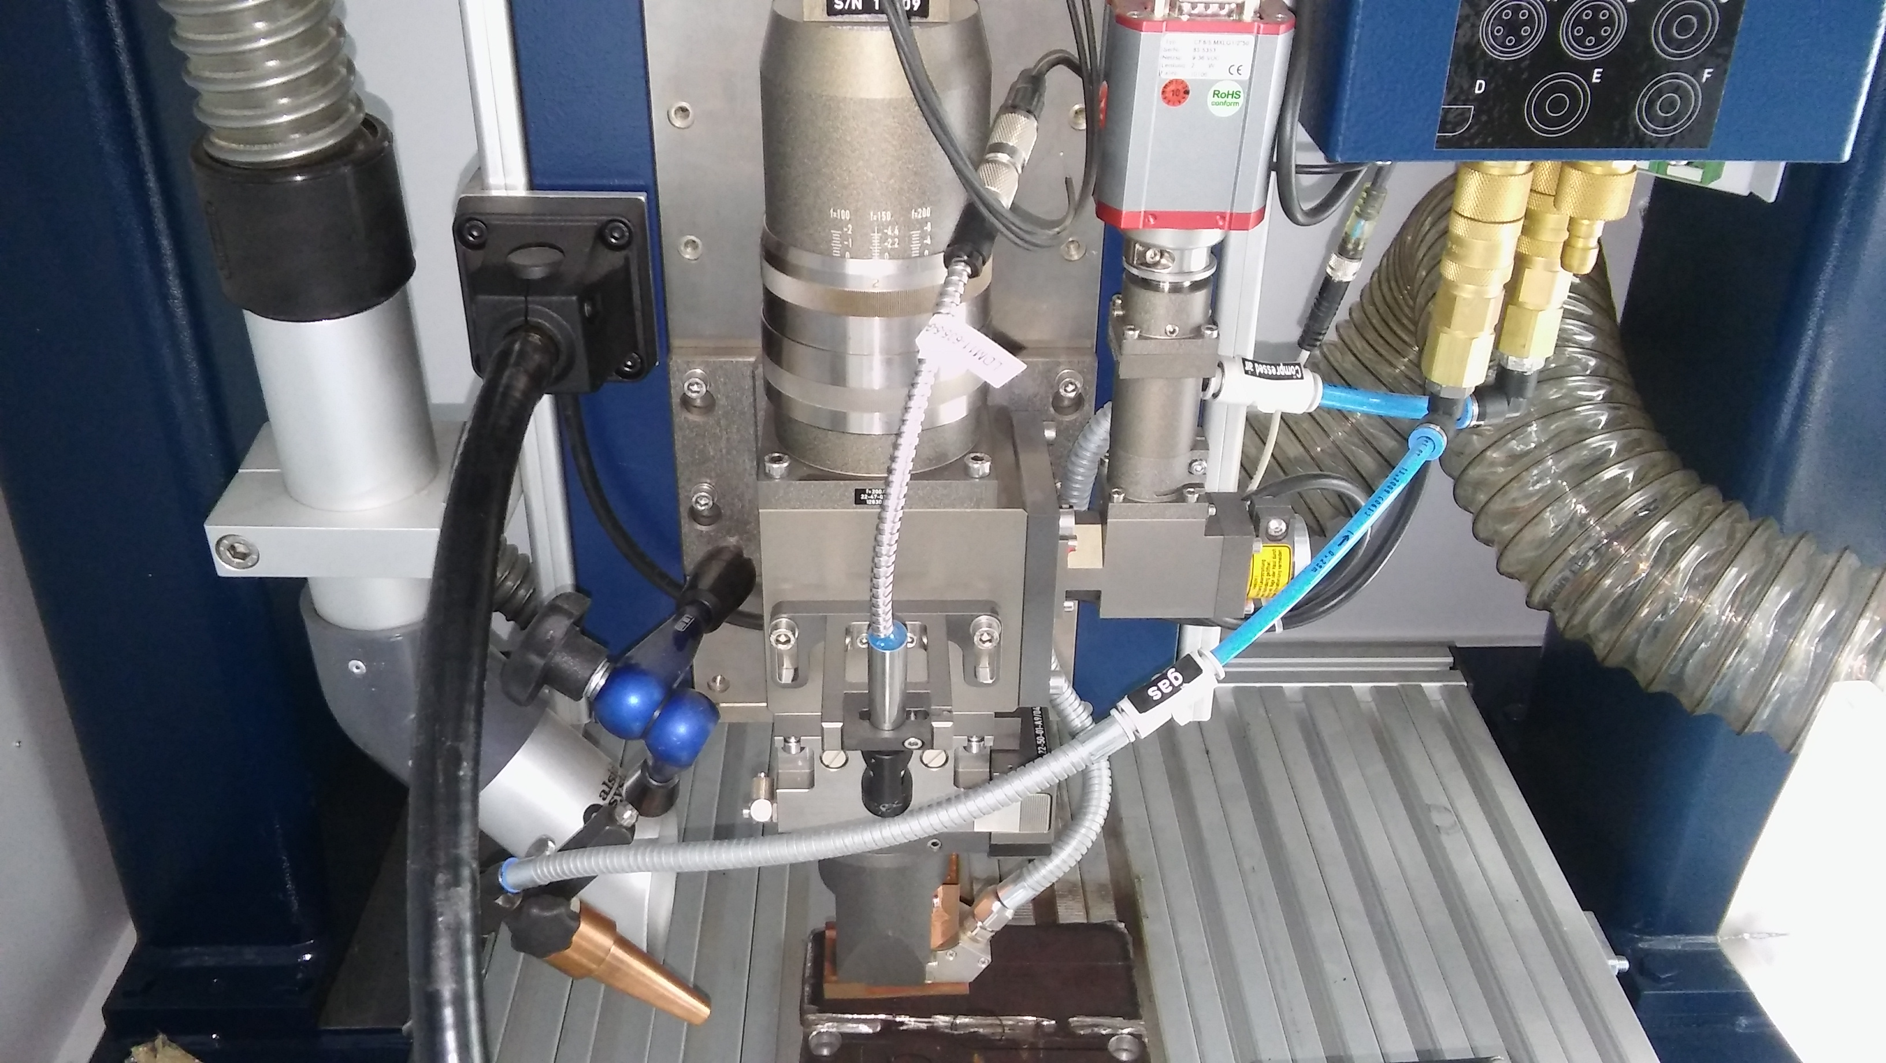
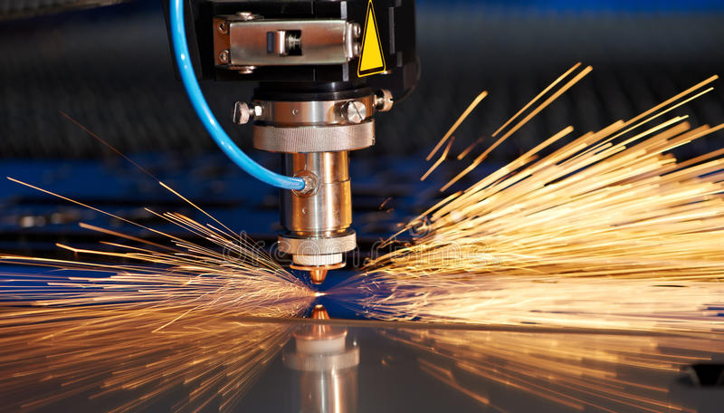
Course Trainers
Course Director: Carlos Casado
Course Trainers: Carlos Casado, Anibal Reñones,
Mireya de Diego
European Photonics Innovation Academy

Slide 6
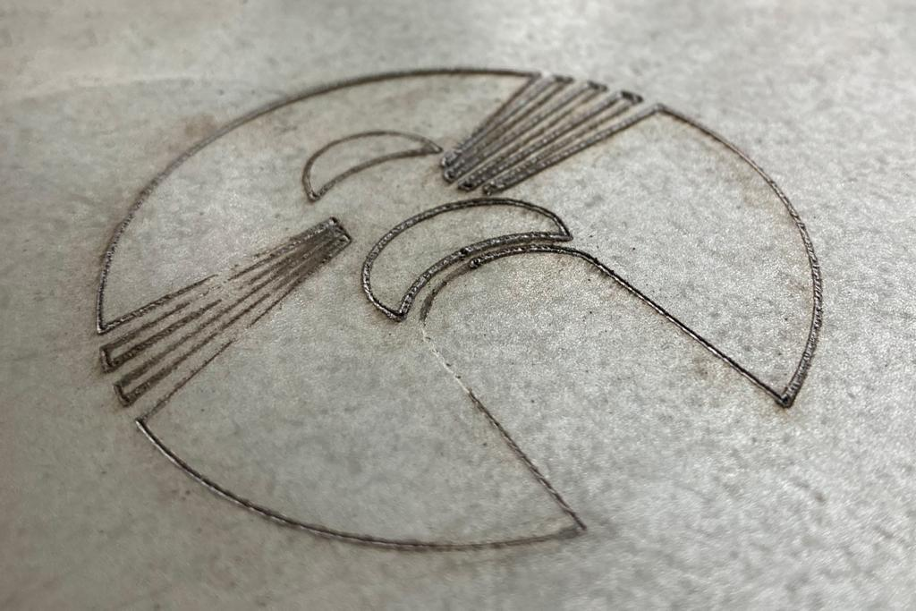
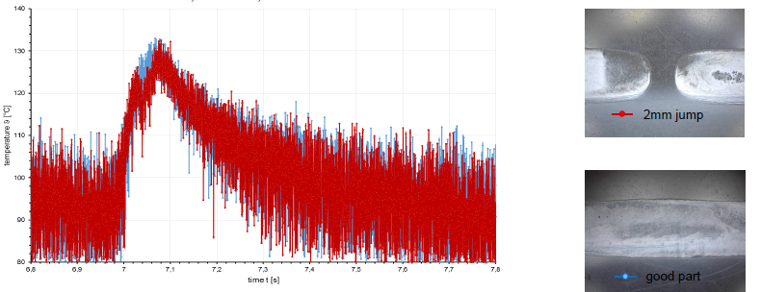
Course Demonstrators
Cutting/marking job
Data remote monitoring and analysis
European Photonics Innovation Academy

Slide 7
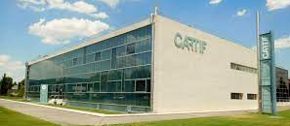
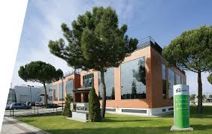
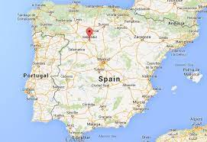

Course Location, Schedule & Cost
CARTIF, Boecillo (Valladolid), SPAIN
Course Schedule (April, November)
Number of people (Groups of 4 to 6 people per course)
Course Cost (100 Euros per person, includes catering, consumables and documentation)
Further Information
carcas@cartif.es, aniren@cartif.es
https://www.cartif.es/comunicacion/contacto/
www.photonhub.eu/euphotonicsacademy
European Photonics Innovation Academy

Slide 8
Course Material (technical hand-outs)
Training course notes
European Photonics Innovation Academy

Slide 9
Keywords
Laser, manufacturing cells, cutting , welding, safety, Industry 4.0, Opc UA, Iot gateways…
Relevant Technology & Application Domain
Technology: Laser-based manufacturing
Application: Manufacturing
European Photonics Innovation Academy

