Slide 1
PhotonHub Demo Centre
Course 02
Photonics for Telecom & Datacom applications
Course Provider
Institute of Communication and Computer Systems,
National Technical University of Athens,
Greece
European Photonics Innovation Academy

Slide 2
Course Overview
Photonic technologies are the cornerstone of modern telecom and datacom communication systems. Evolution of long-haul coherent systems, multilevel datacenter links and 5G optical infrastructure are heavily depended on state-of-the-art transceiver PICs and DSP technologies.
This one-day hands-on training course provides industry, especially those developing new products or addressing an application need, with a detailed overview of important photonic-based transceiver systems and how they are applied in various data communication environments.
The course will focus on three technology demonstrators; 1) High-capacity coherent optical transmission systems; 2) 100Gbaud optical transceivers for datacom links; 3) Optical beamforming technologies for beyond 5G applications. Course attendees will learn how these systems are designed, fabricated and tested.
European Photonics Innovation Academy

Slide 3
Target Audience
It is desirable but not essential that course attendees have a basic understanding of photonics. The course is ideally suited to those planning to develop new photonic products.
Expected Outcomes
Understanding of key features of photonic transceiver for datacom and telecom applications
See the design processes to produce early-stage transceiver devices (hands-on activity)
See and evaluate working devices (hands-on activity)
Understand the photonic product design process and manufacturing ecosystem
European Photonics Innovation Academy

Slide 4
Course Schedule
Time | Demo Activity
09:00 – 10:30 | Course Introduction & Tutorial
11:00 – 12:30 | Demo 1: High-capacity coherent optical transmission systems (hands-on)
14:00 – 15:30 | Demo 2: 100Gbaud optical transceivers for datacom links (hands-on)
15:30 – 17:00 | Demo 3: Optical beamforming technologies for beyond 5G applications (hands-on)
17:00 – 17:30 | Follow-Up Questions & Close
European Photonics Innovation Academy

Slide 5
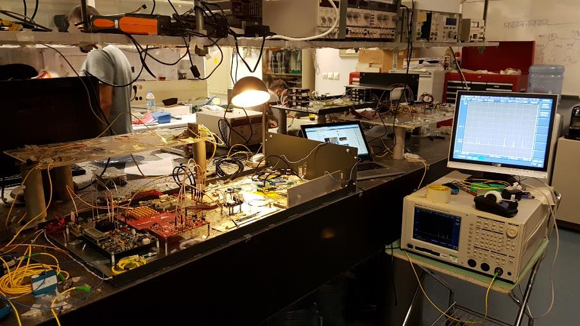
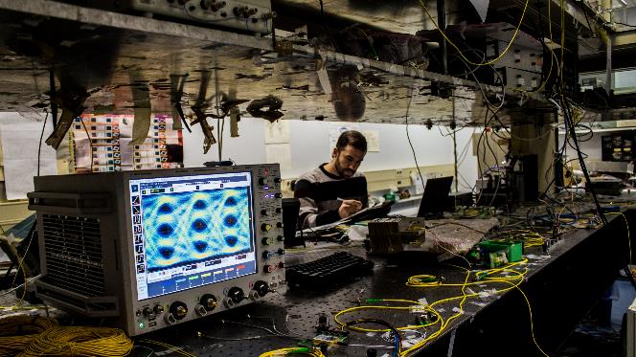
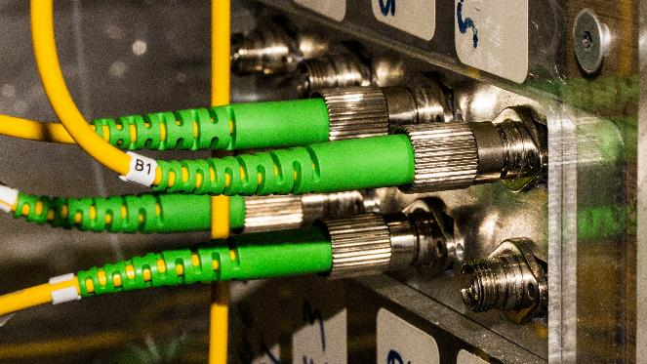
Course Trainers
Course Director: Prof. Hercules Avramopoulos
Course Manager: Dr. Dimitris Apostolopoulos
Demo 1: Dr. Maria Spyropoulou
Demo 2: Dr. Giannis Kanakis
Demo 3: Dr. Christos Tsokos
European Photonics Innovation Academy

Slide 6
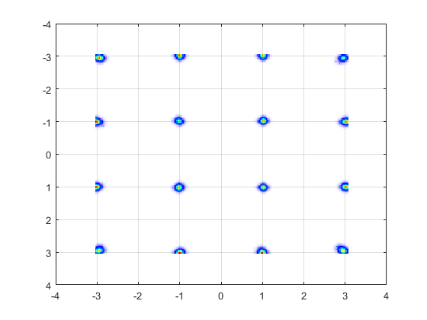
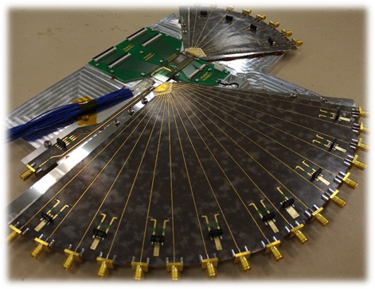
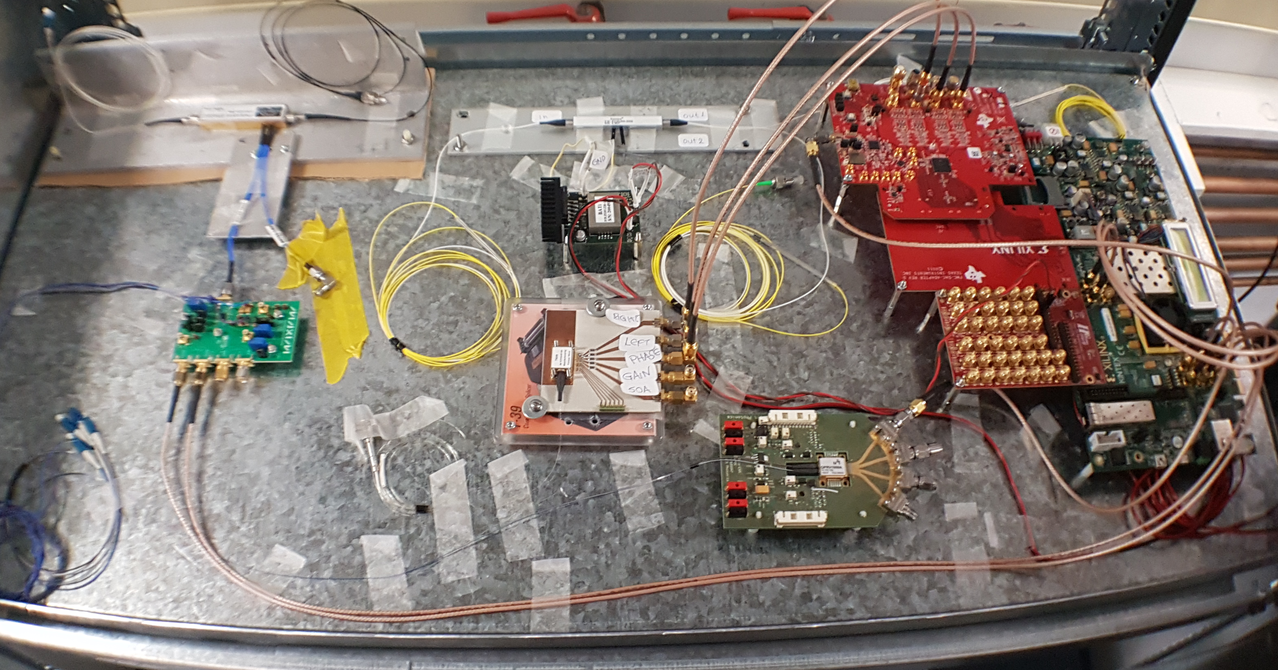
Course Demonstrators
High-capacity coherent optical transmission systems
Optical beamformer
100Gbaud optical transceivers for datacom links
European Photonics Innovation Academy

Slide 7
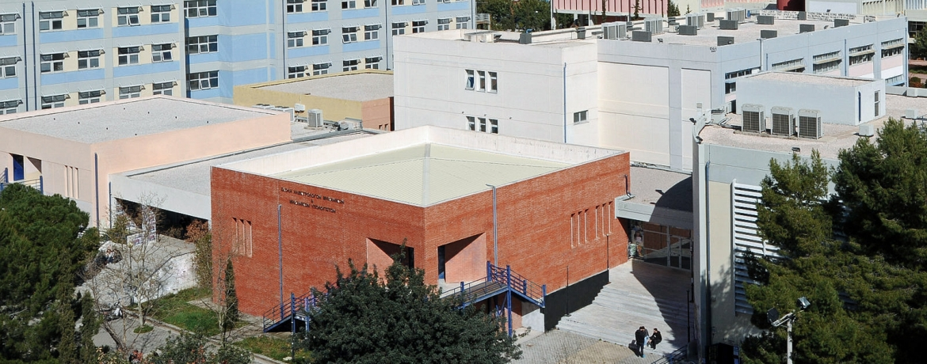
Course Location, Schedule & Cost
ICCS/NTUA, Athens, Greece
(https://goo.gl/maps/eue2qfQ7GTzpdcb27)
Course Schedule (October, March – exact dates to be confirmed)
Number of people (Groups of 6 people per course)
Course Cost (300 Euros per person, includes catering and project consumables)
Further Information
apostold@mail.ntua.gr
https://www.photonics.ntua.gr/contact-us/
www.photonhub.eu/euphotonicsacademy
European Photonics Innovation Academy

Slide 8
Course Material (technical hand-outs)
Course notes to be provided for each demo.
European Photonics Innovation Academy

Slide 9
Keywords
Optical communications, Datacenter interconnects, Optical transceivers, Optical networks, 5G,
PICs, Integrated Photonics, Silicon photonics, optical system design, Coherent communications,
Digital signal processing.
Relevant Technology & Application Domain
Technology: Silicon Photonics, InP-based PICs
Application: ICT
European Photonics Innovation Academy

